Slide 1

SIG JS Tooling
08-08-2019

Slide 2
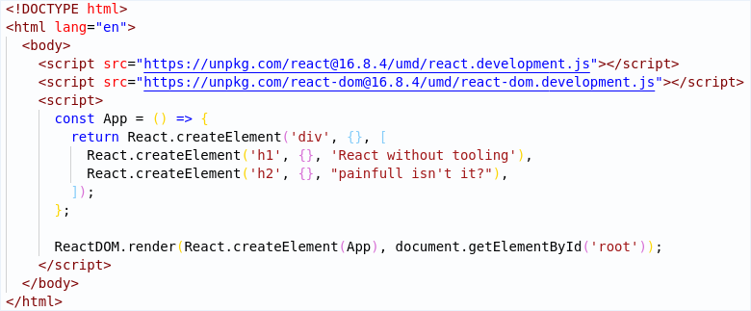
What would life be like without tooling?
JS Tooling
1

Slide 3
What is Tooling
JS Tooling
1

Slide 4




















Linters
Types of Tooling
Runners
Bundlers
Transpilers
Testing frameworks
JS Tooling
1

Slide 5
Task Runners
Orchestration of other tools
Achieved through plugins
Problematic in maintenance
Runners are not used in modern js. NPM scripts are used instead.
JS Tooling
1

Slide 6

NPM
Dependencies
Scripts
Config
Documentation
JS Tooling
1

Slide 7
Bundlers
https://medium.com/js-imaginea/comparing-bundlers-webpack-rollup-parcel-f8f5dc609cfd
JS Tooling
1

Slide 8
Transpilers
JS Tooling
1

Slide 9
Linters
JS Tooling
1

Slide 10
Prettier & Editorconfig
JS Tooling
1

Slide 11
Testing
JS Tooling
1

Slide 12

Dinner & Hands On
It’s dinnertime!
React
1

